Slide 1
Boston Area Activity Groups
Robert Rasor, Charles Keough, Grant Zobel, Max Montes-Soza, Jacob Goodgame

Slide 2

The Problem
“I’m new to Boston. How do I make friends, continue my social activities, or join new ones?”
“I spend every weekend staring at the walls of my dorm. What do I do?”
Finding activity groups on the internet is difficult, as the information is decentralized and disorganized.

Slide 3
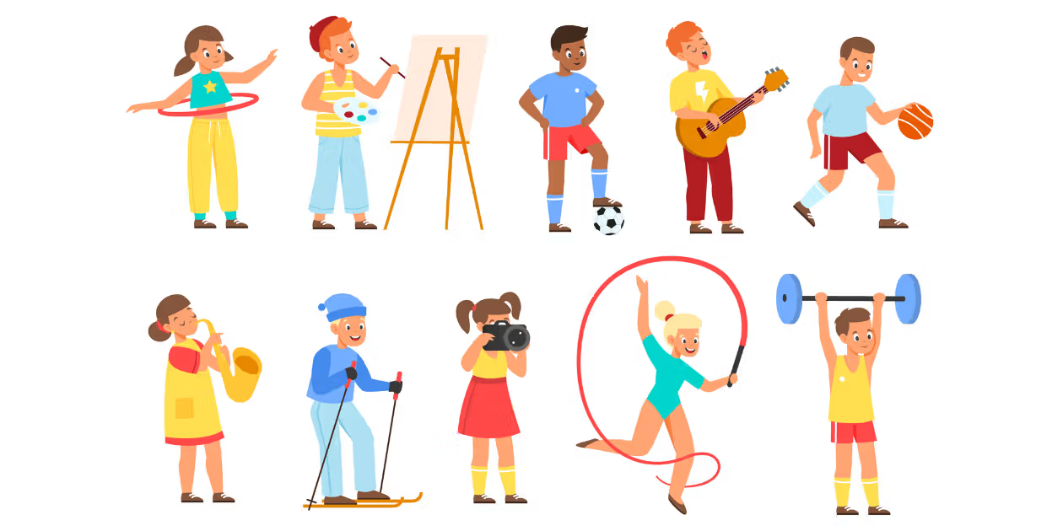
Solution
Organized database of activity groups and events.
Will allow users to browse for desired events or activity groups according to their interests.
Will allow users to contact people in charge of groups/events and find information about the group via website links.
Will allow people to form their own groups as well!
This way, the task of navigating activity groups is centralized, removing the burden of scouring the internet.

Slide 4
A Couple of Considerations
Number of Features vs. Ease of Use
We ended up settling on a streamlined model that simply allows users to join groups at will, which would allow groups to handle their own politics/membership issues somewhere else.
User Enters vs. User Selects
Do users enter college name or select from a list of Boston area colleges?
Answer: select from a list! This reduces redundancy and overhead.

Slide 5
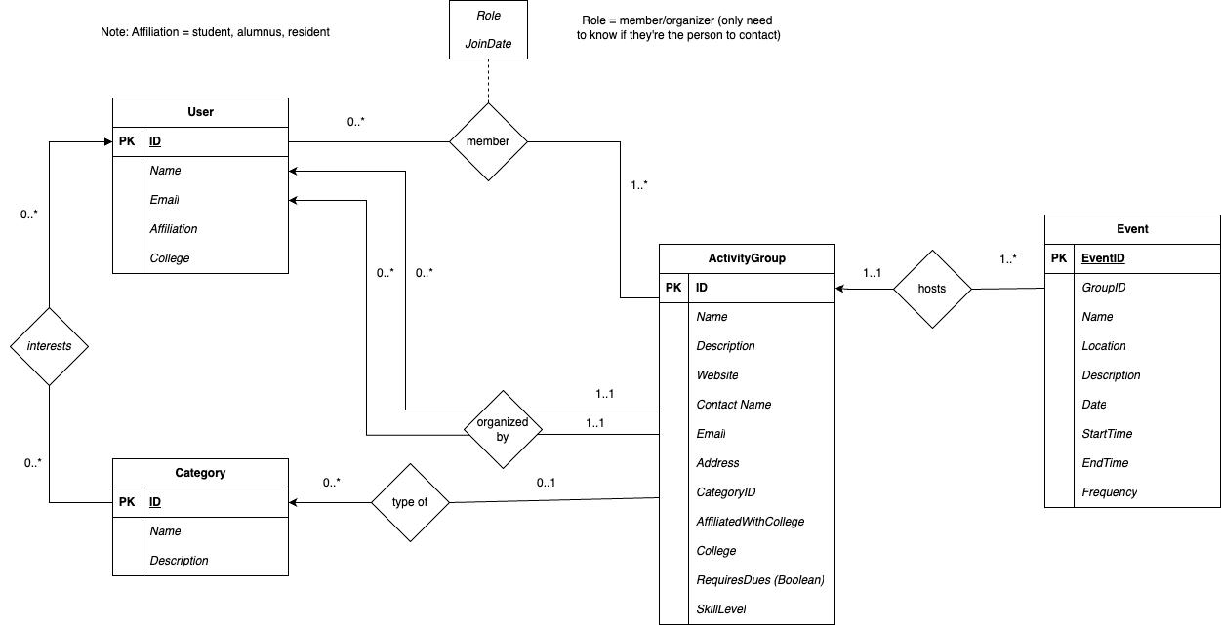
ER Analysis
*We originally planned to allow events unassociated with activity groups but decided against it.

Slide 6
Schema (Pt. 1)
User (ID, Name, Email, Affiliation, College)
* Name must be unique and not null
* Email must be unique and not null
* Affiliation must be 'student', 'alumnus', or 'resident'
Authentication (UserID, PasswordHash, SessionID) —---- not included in initial plan
* UserID references User(ID)
* PasswordHash must be not null
Category (ID, Name, Description)
* Name must be unique and not null
ActivityGroup (ID, Name, Description, Website, ContactName, Email, Address, CategoryID, AffiliatedWithCollege, College, RequiresDues, SkillLevel)
* Name must be not null
* SkillLevel (Must be ‘beginner’, ‘intermediate’, or ‘advanced’),
* Foreign Key (CategoryID) references Category(ID)

Slide 7
Schema (Pt. 2)
Event (EventID, GroupID, Name, Location, Description, Date, StartTime, EndTime, Frequency)
* Foreign Key (GroupID) references ActivityGroup(ID) not null
* Name must be not null
* Date must be not null
Membership ((UserID, GroupID), Role, JoinDate)
* Foreign Key (UserID) references User(ID),
* Foreign Key (GroupID) references ActivityGroup(ID)
* Role must be 'member' or 'organizer'
UserInterest ((UserID, CategoryID)) —- Didn’t get to implement this yet, but hope to expand with this.
* Foreign Key (UserID) references User(ID),
* Foreign Key (CategoryID) references Category(ID)

Slide 8
General Interface
Can browse events or group with or without login
Browsing groups and browsing events are separate pages
Browse by category
Menu of activity groups of which a user is Member or Organizer (“My Groups”) —- requires being logged in
Can join activity group as a Member, can leave group as well
Users can enter new activity groups into the database as an Organizer
to add activity group, attributes are selected/entered by user
Categories are fixed
Contact Email is Organizer’s login email
Activity groups created by user list them as Organizer
from this menu, you can add events under each group
has list of members available
leaders can remove/disband their group

Slide 9
Demo
chrome://net-internals/#sockets

